Slide 1
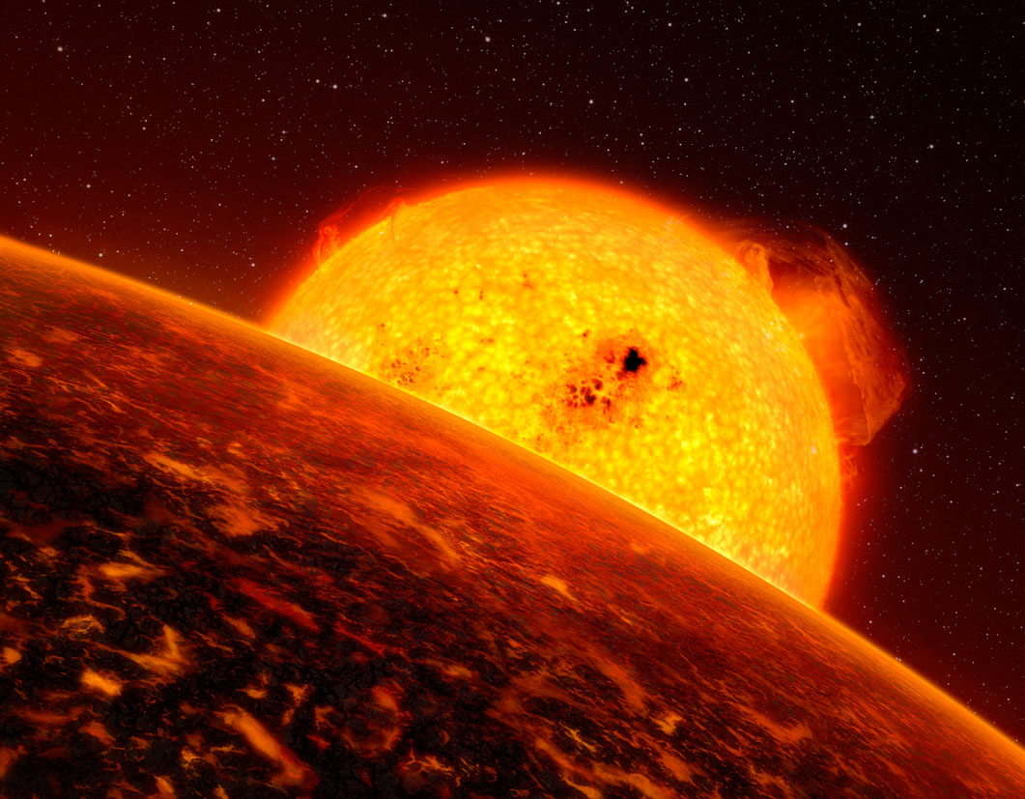
Practical assignment
Discover Exoplanets
Notes:
Artist’s impression of Corot-7b eso

Slide 2
Exoplanets have long been speculated to exist
1987 First predictions
1990’s large object revolving round a pulsar
…
Exoplanet.eu (>1000 planets listed)
Notes:
How many stars in our galaxy >1E9
How many galaxies in our universe >1E9
Opinions differed:
There are infinite worlds both like and unlike this
world of ours’ (Epicurus, 341–270 BCE) to ‘There cannot
be more worlds than one’ (Aristotle, 384–322 BCE).
Pulsar not a star that you want to live next to

Slide 3
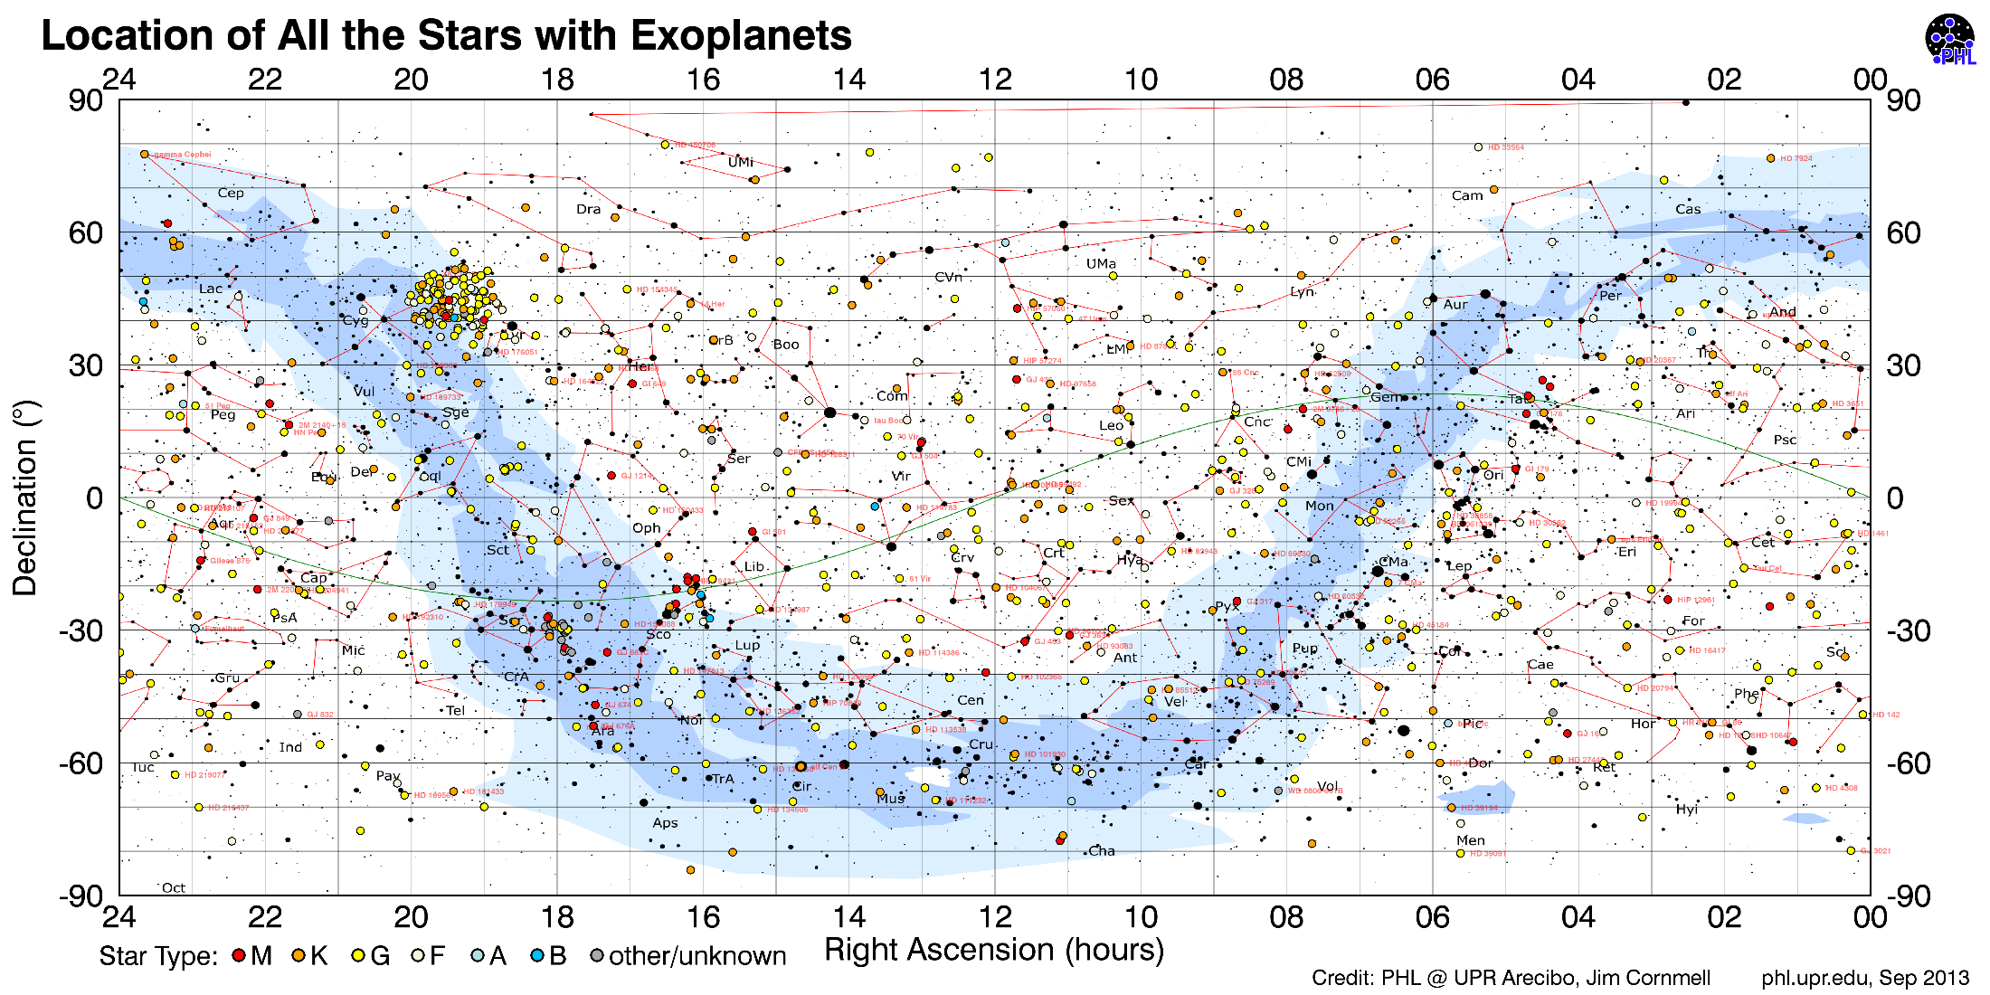
Notes:
The blob coincides with the field of view of Kepler telescope

Slide 4
Why are exoplanets so hard to find?
Planets are much smaller than stars
No light source, reflection only (albedo)
Overexposed by starlight
Notes:
How many stars in our galaxy >1E9
How many galaxies in our universe >1E9
Opinions differ:
There are infinite worlds both like and unlike this
world of ours’ (Epicurus, 341–270 BCE) to ‘There cannot
be more worlds than one’ (Aristotle, 384–322 BCE).
Pulsar not a star that you want to live next to

Slide 5
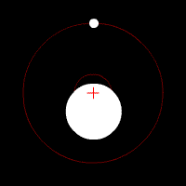
Mechanics
Star and planet evolve around the same barycenter
Notes:
http://astro.unl.edu/naap/esp/centerofmass.html

Slide 6
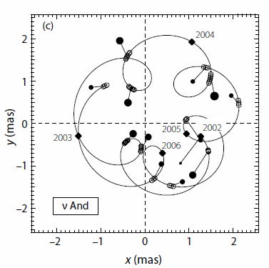
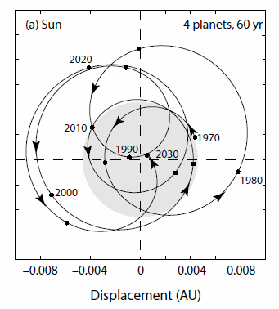
Detection Methods
Astrometry, direct observation of star
Notes:
Astronomers can watch not touch
Astrometry unit mas is unit of length (major axis)

Slide 7
Detection Methods
Overview
Notes:
Astronomers can watch not touch
Astrometry unit mas is unit of length (major axis)

Slide 8
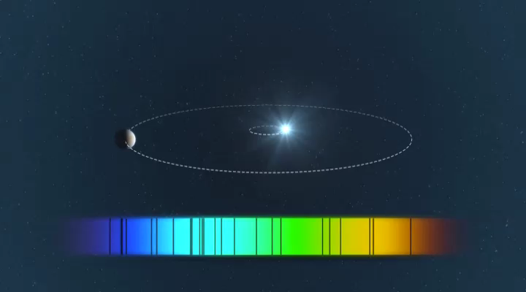
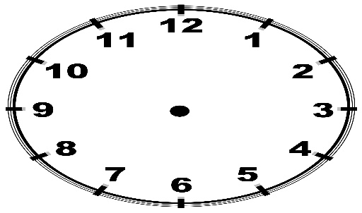
Detection Methods
Radial velocity
Where is the observer?
Notes:
Astronomers can watch not touch
Spectroscopy, laws of physics same everywhere in the universe
Where is the observer in the eso animation?
Blueshift max when planet is at 3
Star is then at 9 and moving towards observer at 6 oclock

Slide 9
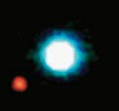
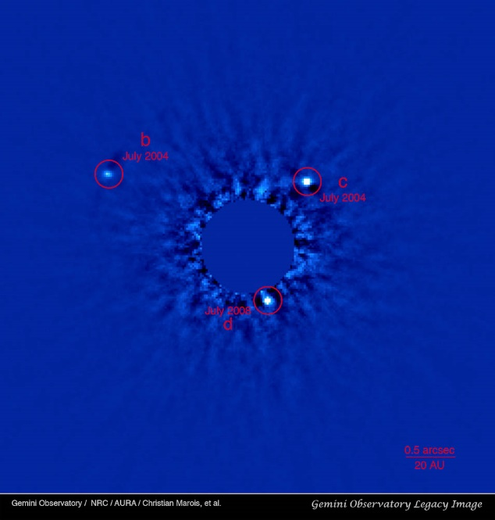
Detection Methods
Direct imaging
Notes:
Turbulence and atmospheric absorption hinder observations from earth

Slide 10
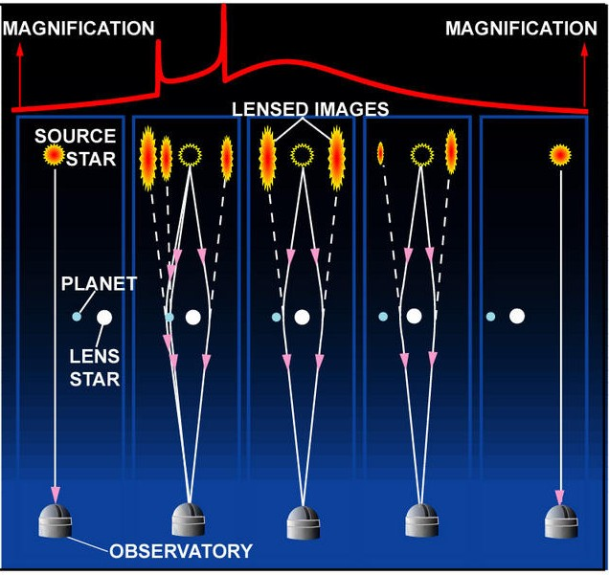
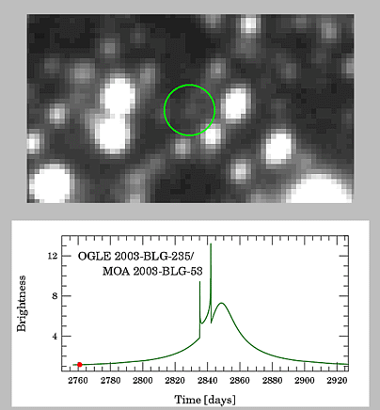
Detection Methods
Microlensing (Einstein’s general relativity)
Notes:
http://www3.nd.edu/~bennett/moa53-ogle235/

Slide 11
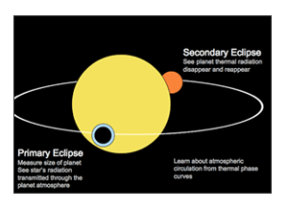
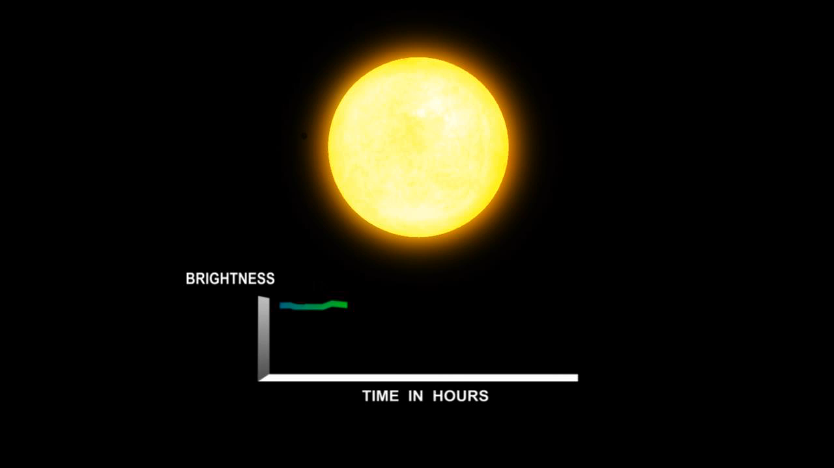
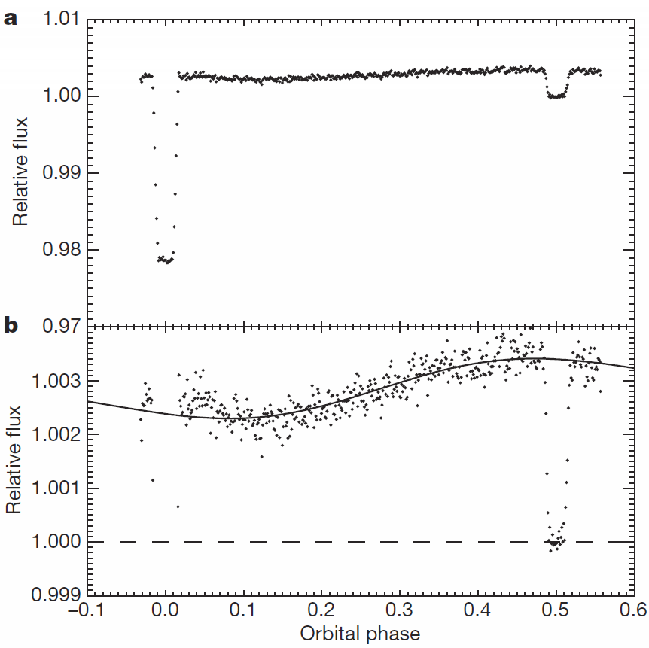
Detection Methods
transit or occlusion
Notes:
Knutson et al NATURE| Vol 447| 10 May 2007

Slide 12

The assignment
Question:
What is the relation between the diameter of a planet and the star’s intensity dip during a transient passage.
Obviously: the larger the planet, the deeper the dip. Find a mathematical relation. Write that relation in a linear form.
Measurements:
Take four planets of different sizes. Measure their diameters with calipers (This is something astronomers can’t do).
Measure the deflections (at least three readings each) and plot the data.
Manipulate your data so you can plot it in a linear graph (Excel). This is your calibration graph (nice if you put in error bars).
Take a fifth planet and derive its diameter from its transient and your calibration curve. This is the astronomers way!
Check with your calipers, and compare with your transient measurement.
Astronomers know the size stars. Our star has diameter of 40 mm (official match ball)

Slide 13
First: Set up your system

Slide 14
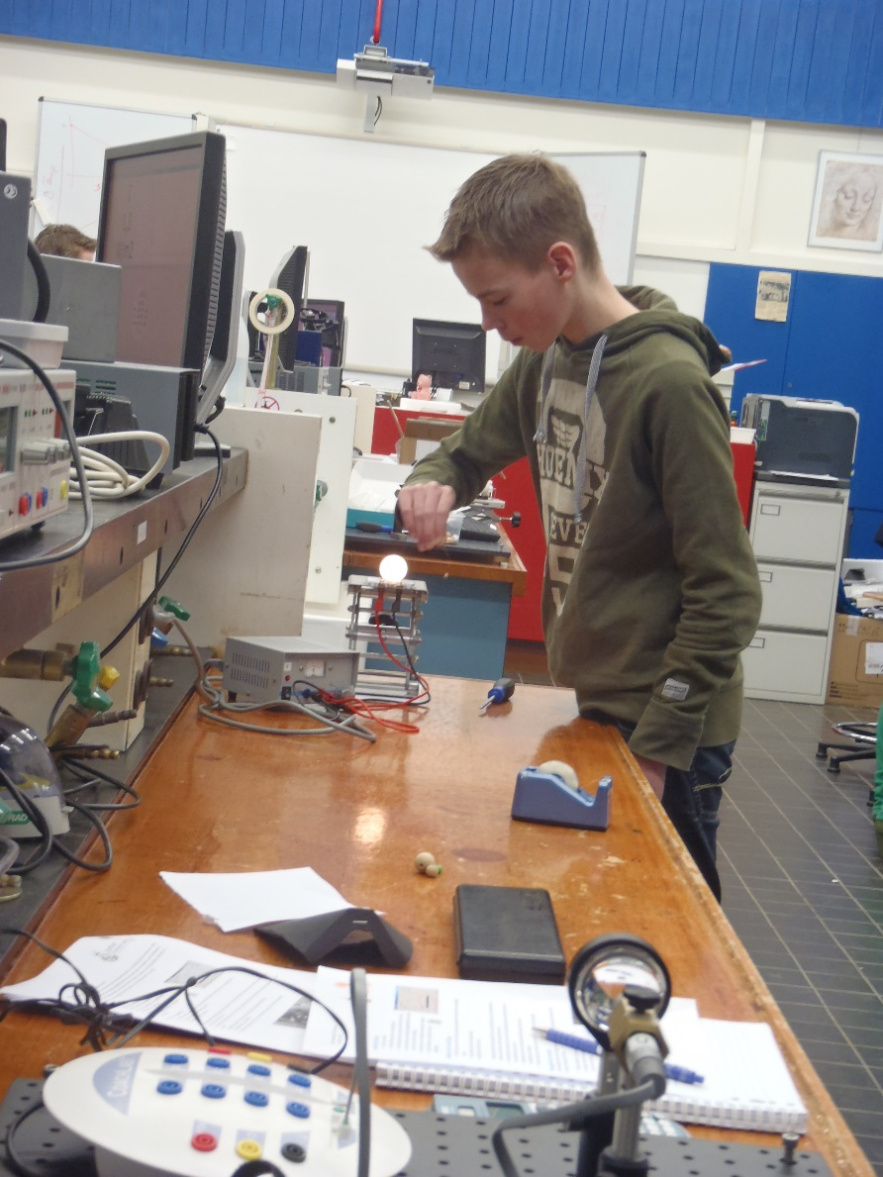
Build planetary system on this end
Make this distance as large as possible
workbench
Build telescope system on this end
(where the computer is)

Slide 15
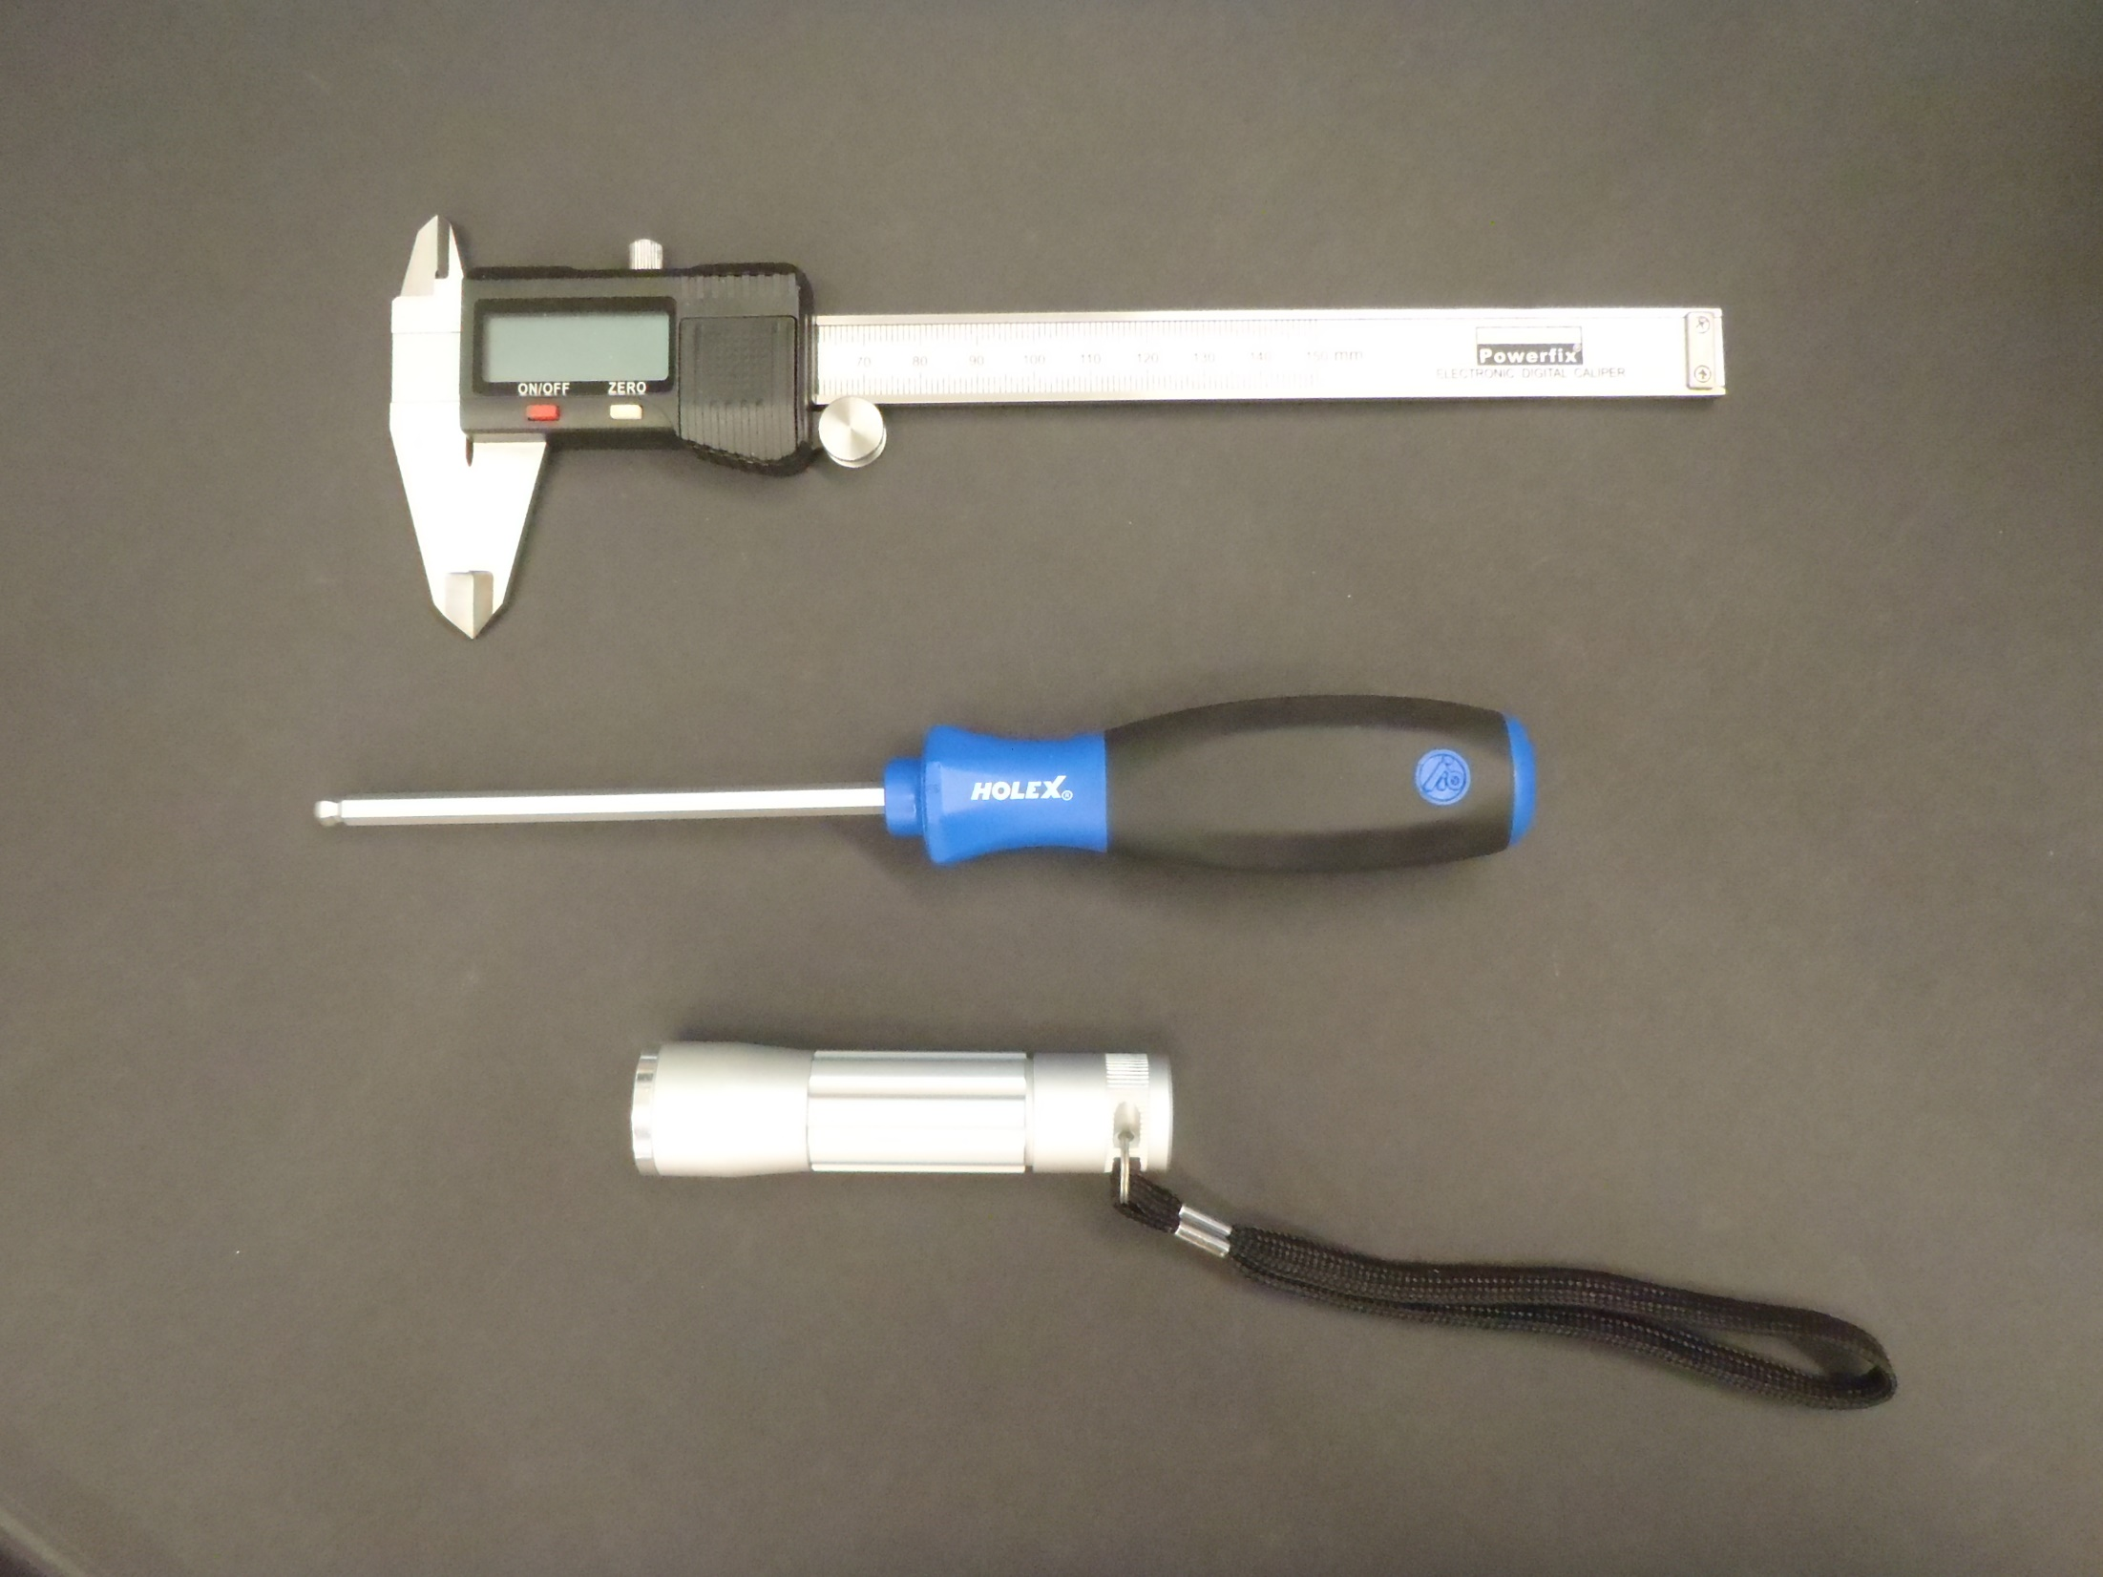

Slide 16
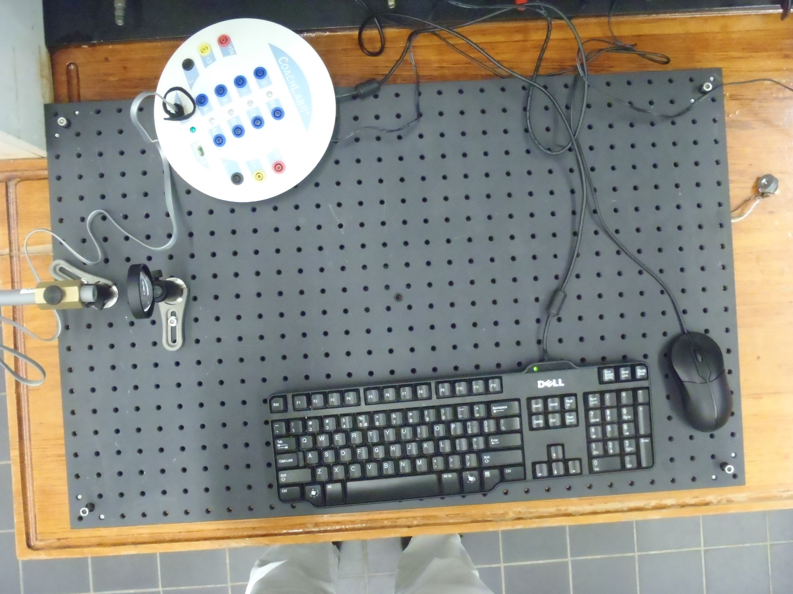
Computer interface
Adjust 1 of 4 for stability
Careful with lens.
Place lens convex side up side on a piece of paper when not used
Optical breadboard
Special screw

Slide 17
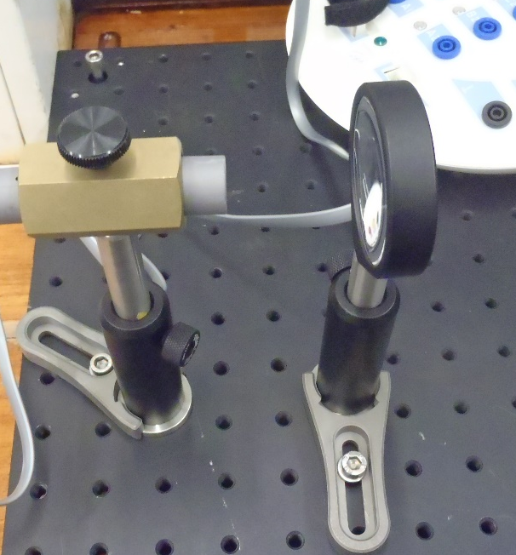
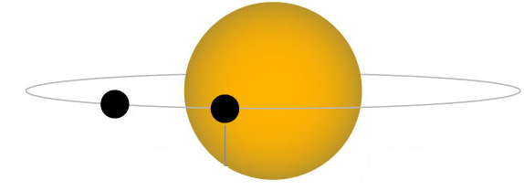
The sensor is very small …
If you want to image the star and its planet …

Slide 18
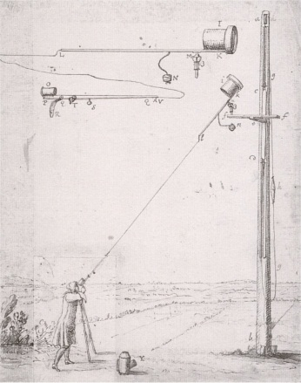
Tubeless telescope (Christaan Huygens)
When is a tube not needed?

Slide 19
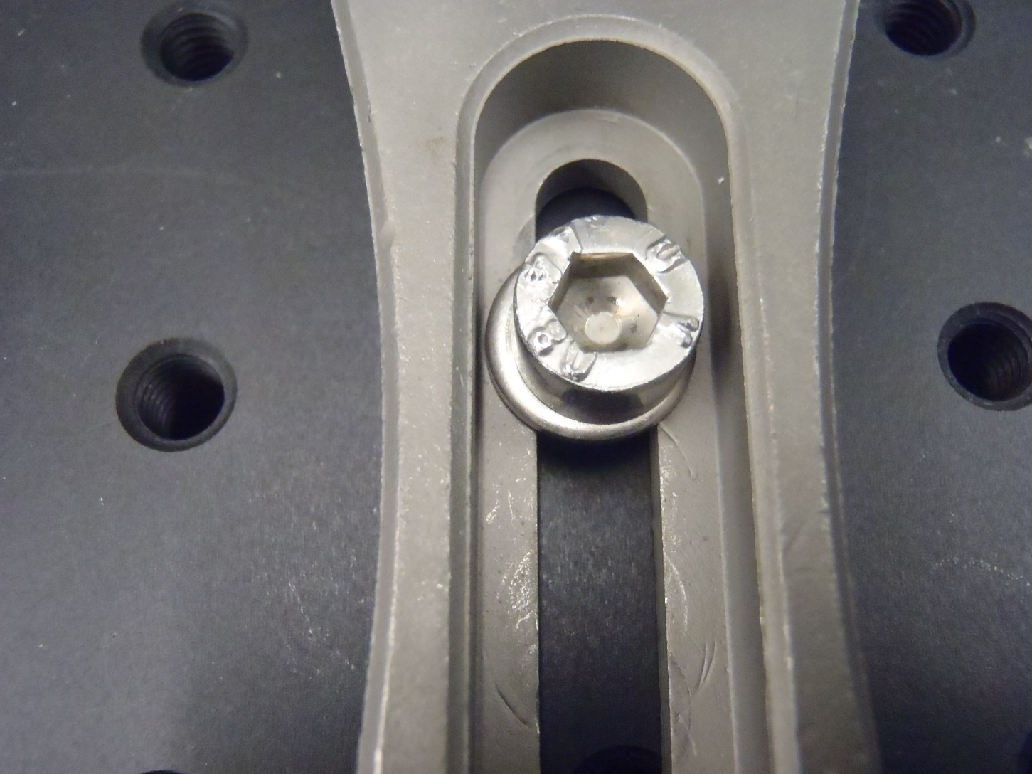
Hex screw
Use a washer with hex screw
Clamping fork

Slide 20
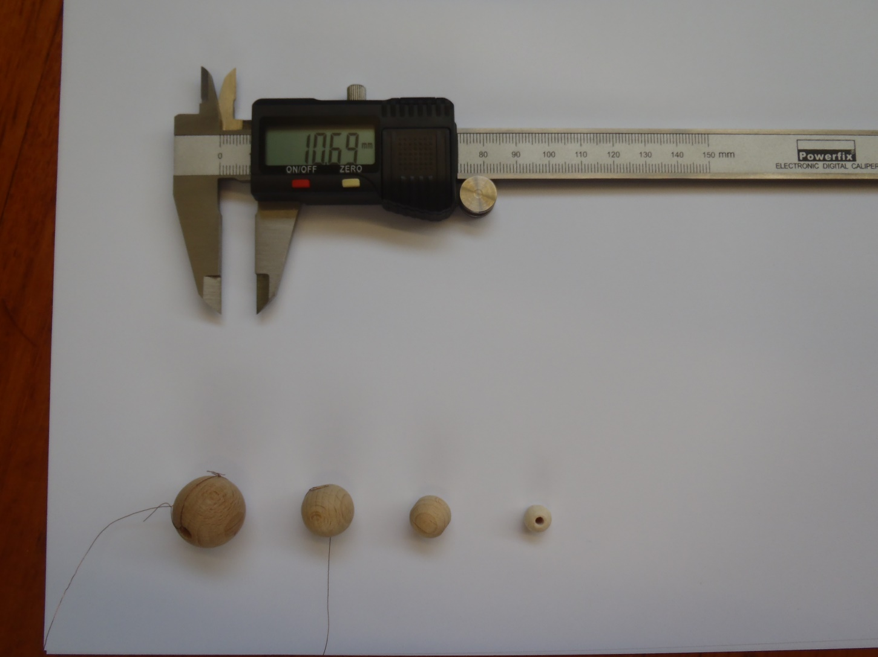

Slide 21
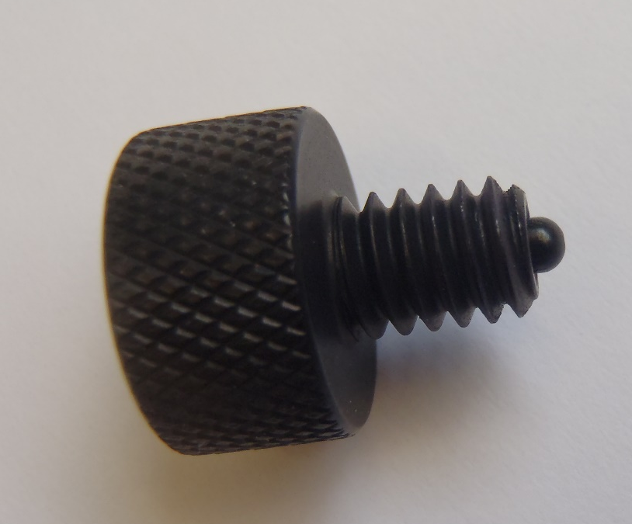
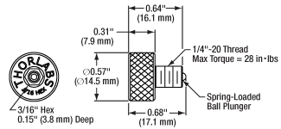

Slide 22
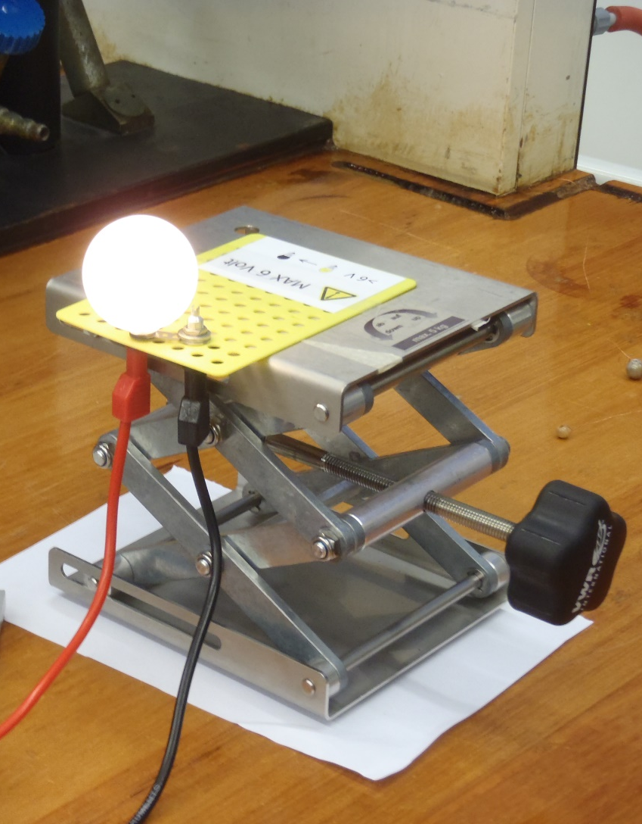
Labjack knob
Z-axis positioning
Labjack on paper sheet
Y-axis positioning

Slide 23
IPCOACH settings
Load activity Discover Exoplanets
Sample time 100 sec
Sample freq 1000 Hz

Slide 24
Assignment:
Derive a relation between the change in light intensity during a passage and the size of the planets.
Make a linear calibration curve using four planets with known diameters (calipers).
Use the aclibration curve to predict the diameter of a fifth planet from your light signal.
Check your result using calipers.
Discuss the uncertainties (systematic errors) and make suggestions to improve the setup.

Slide 25
Drake’s equation
N = R* • f_{p} • n_{e} • f_{l} • f_{i} • f_{c} • L
R* = the average rate of star formation in our galaxy
f_{p} = the fraction of those stars that have planets
n_{e} = the average number of planets that can potentially support life per star that has planets
f_{l} = the fraction of planets that could support life that actually develop life at some point
f_{i} = the fraction of planets with life that actually go on to develop intelligent life (civilizations)
f_{c} = the fraction of civilizations that develop a technology that releases detectable signs of their existence into space
L = the length of time for which such civilizations release detectable signals into space

Slide 26
What is the chance we find aliens (or aliens find us) with the transient method
Diameters: earth/sun = 1/100
Distance sun/earth = 1/100 sun diameters
K
x
y
h
O
P
S
Notes:
The surface of the sphere is:
$$A=4πK^{2}$$
What is the fraction of this surface cast by the shadow of the planet (P)?
$$x+y=D$$
$$\frac{2R_{p}}{x}=\frac{2R_{s}}{D−x}$$
$$2R_{p}\left(D−x\right)={2R}_{s}x$$
$$DR_{p}=x(R_{p}+R_{s})$$
$$x=\frac{DR_{p}}{(R_{p}+R_{s})}$$
On the ribbon (use $K−y≈K$):
$$\frac{h}{K}=\frac{2R_{p}}{x}$$
$$h=\frac{2R_{p}K}{x}$$
$$h=\frac{2R_{p}K}{\frac{DR_{p}}{(R_{p}+R_{s})}}$$
$$h=\frac{2K(R_{p}+R_{s})}{D}$$
Fraction:
$$f=\frac{surface of the ribbon}{surface of the sphere}=\frac{2πKh}{4πK^{2}}=\frac{R_{p}+R_{s}}{D}$$
If we apply this to our own planet and sun:
Radius of the sun , R_{s} = 7x10⁸ m
Radius of the earth, R_{p} = 6,3x10⁶ m
Orbital radius D_{ps} = 1,5 x 10¹¹ m
Note that roughly holds:
R_{s}=100R_{p} and D_{ps}=200R_{s}
The chance that an alien observes our planet is therefore about 0.5%.
There are further restrictions. The planet can only be observed during a passage. The duration of an eclipse can be calculated from the ratio of R_{s}/D_{ps}. The duration of an eclipse at equatorial passage is about 12 hours. Since the diameter of the sun is about 100 times the diameter of the earth, the expected dip in magnitude 0.1%.

Slide 27
